Slide 1
Nordonia High School Science Olympiad
2014 Awards Ceremony

Slide 2
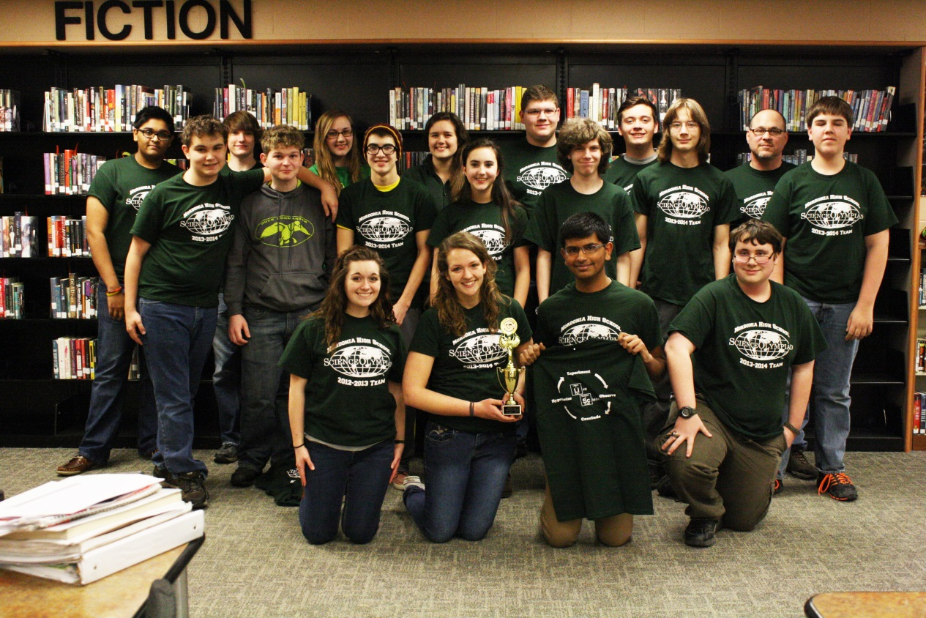
The 2014 NHS Sci Oly Team

Slide 4
WESTLAKE - HIGHLIGHTS
GETTING EVERYONE AFTER VACATION
PARENTS RUNNING BUNGEE DROP
AWARDS: BUNGEE – 6th, XD-5TH, MP-4TH
ELASTIC LAUNCHED GLIDER – 3rd

Slide 5
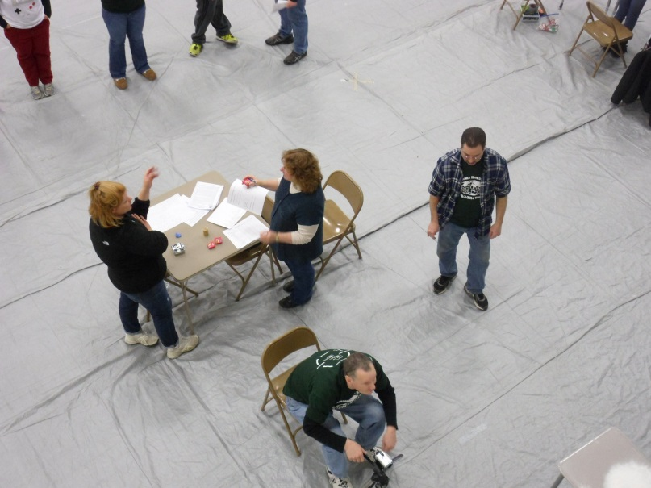
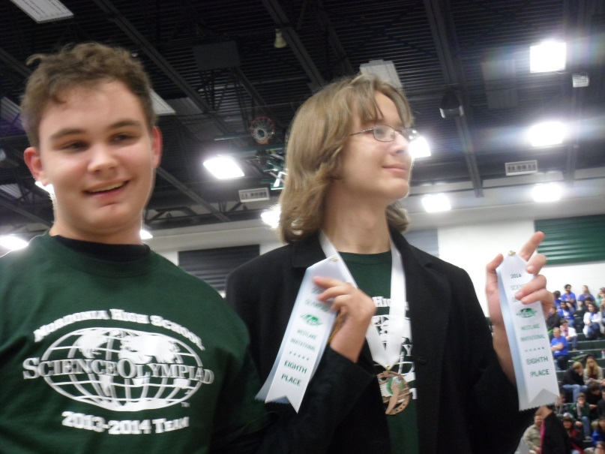
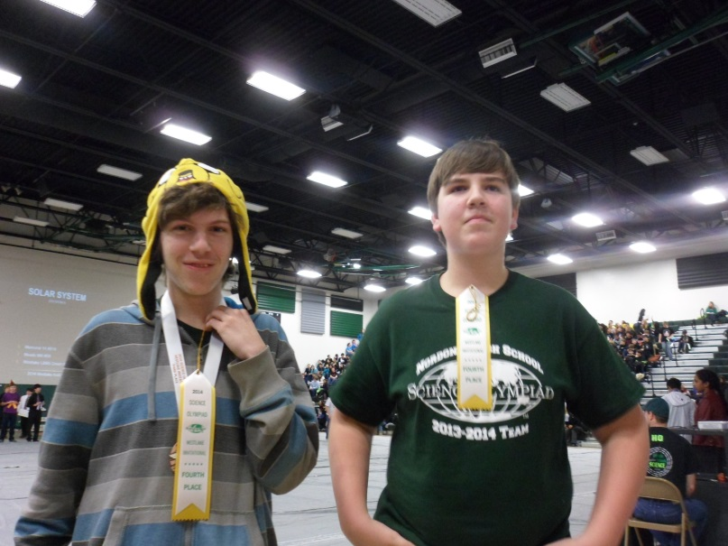
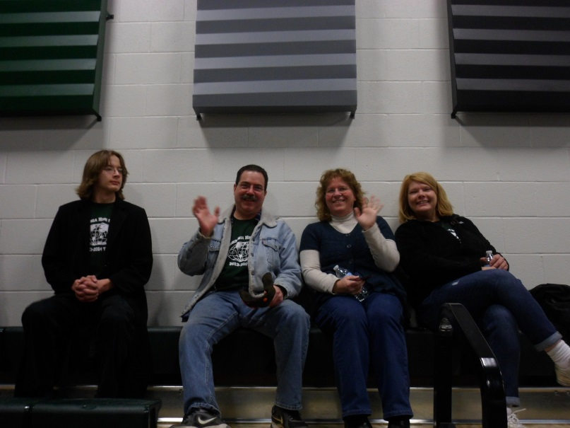
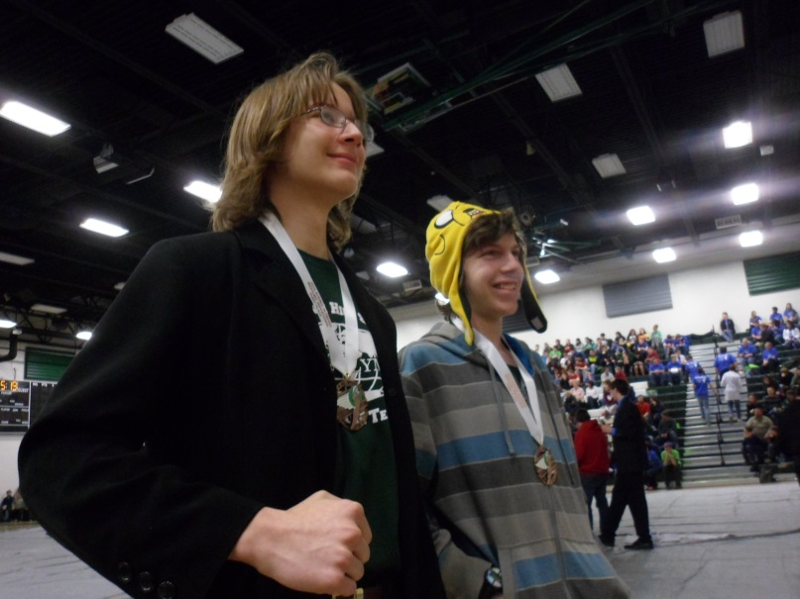
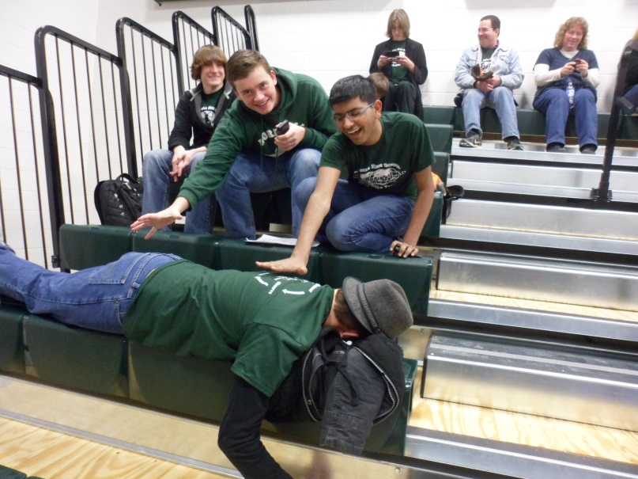
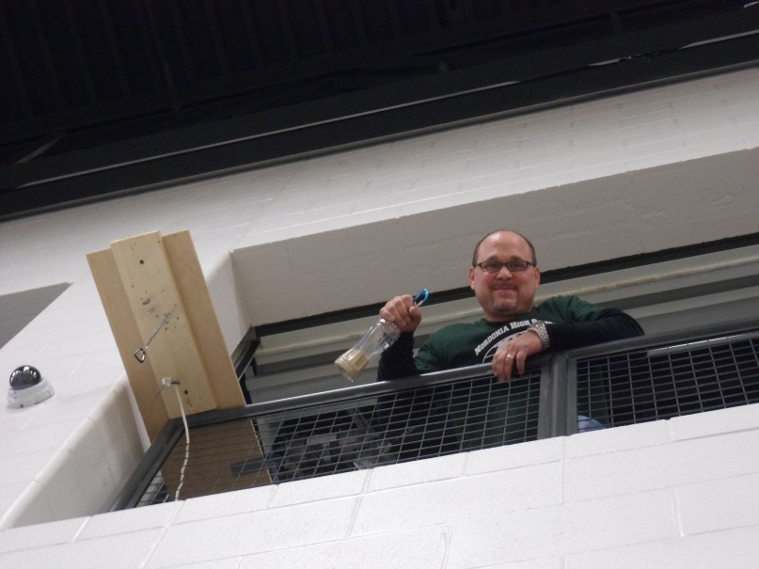

Slide 6
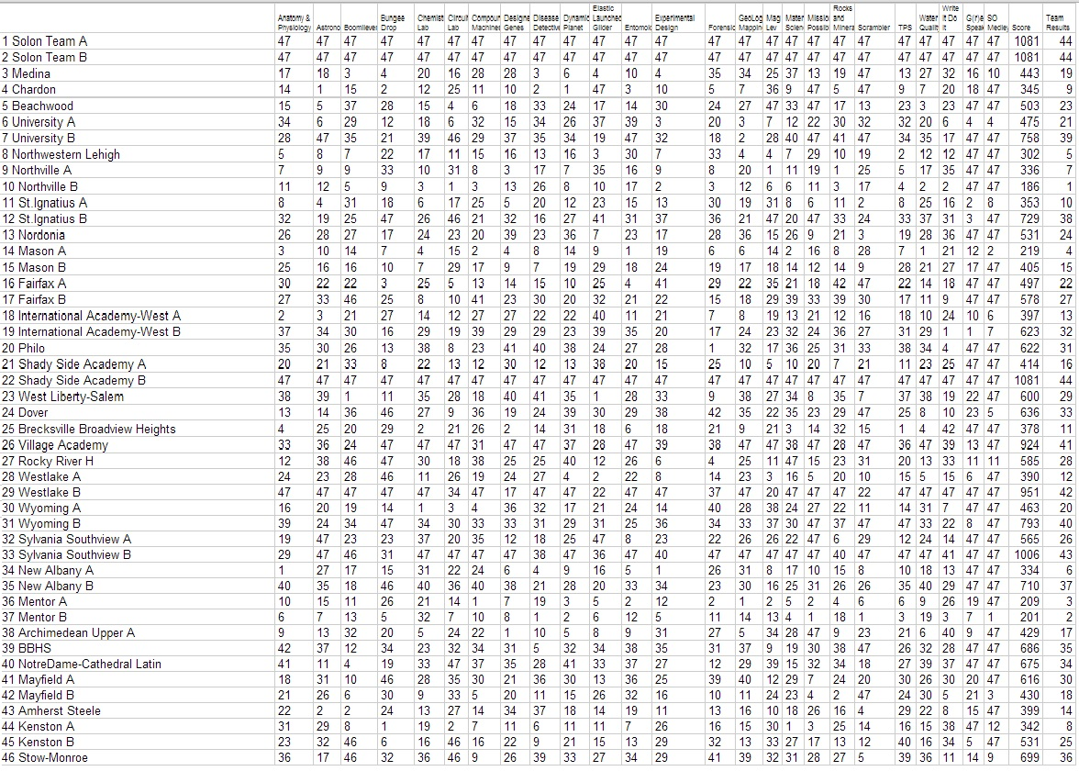

Slide 7
SOLON - HIGHLIGHTS
PARENTS RUNNING BUNGEE DROP
CHECK-IN
HANGING OUT IN THE CAFETERIA - AGAIN
AWARDS: SCRAMBLER-3rd
ELASTIC LAUNCHED GLIDER – 7th

Slide 8
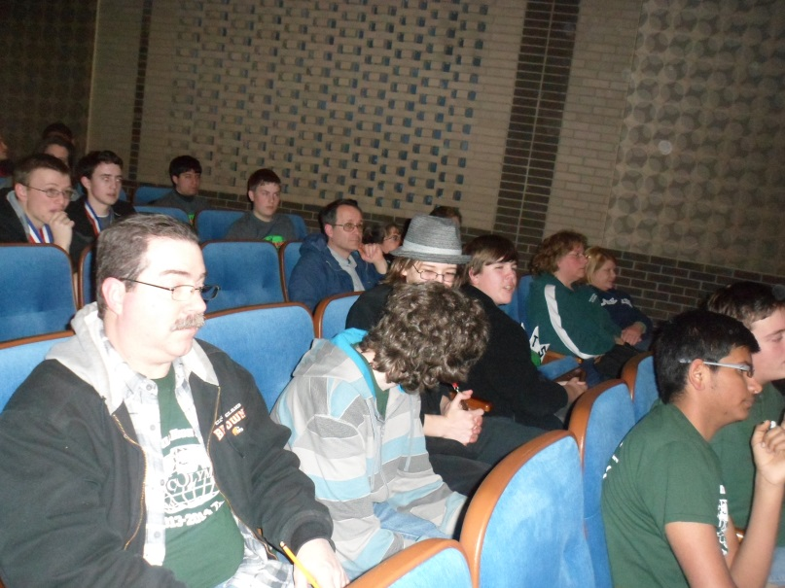
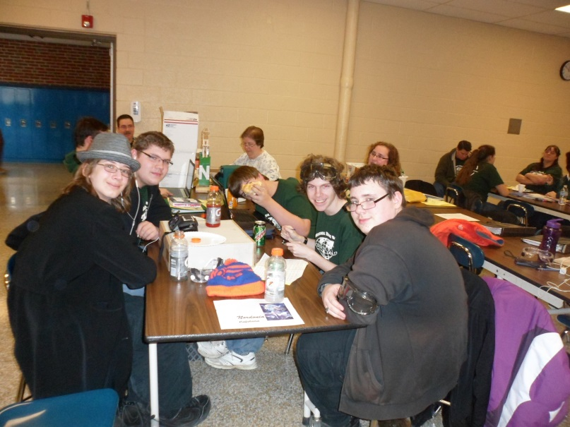
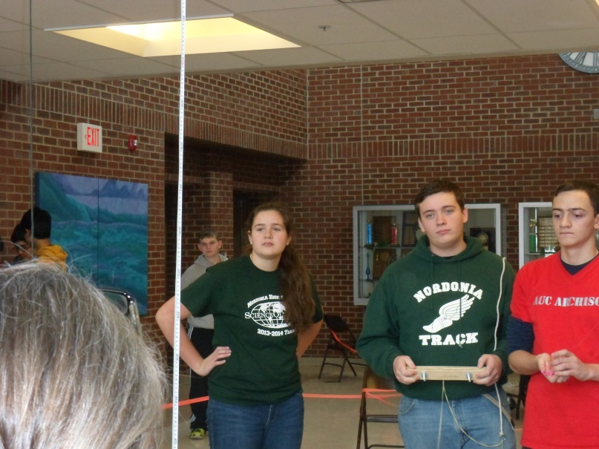
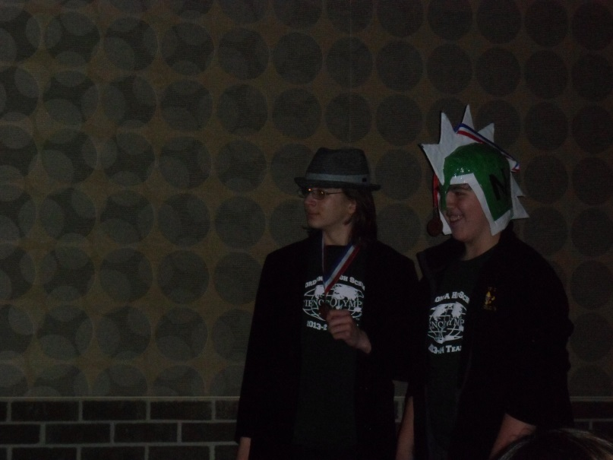
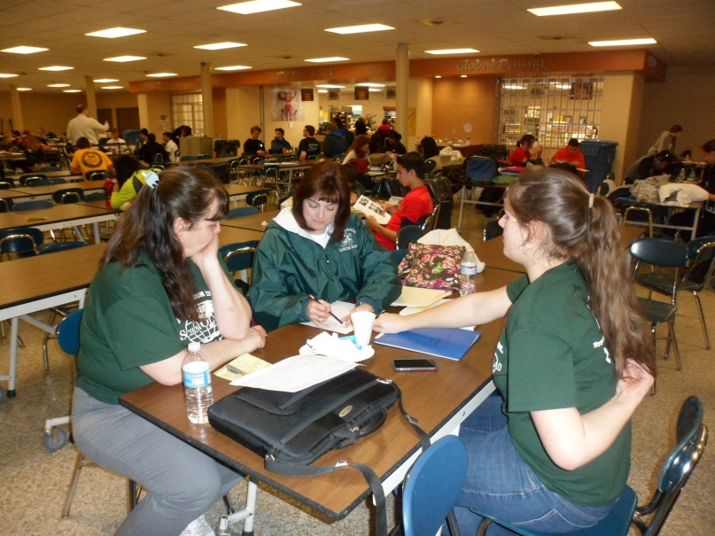

Slide 10
MENTOR - HIGHLIGHTS
PARENTS RUNNING SCRAMBLER - SPLAT
AWARDS: MP-3rd MAGLEV- 5th (Wake-up)
WRITE IT DO IT – 1st (You’re Joking, Right?)

Slide 11
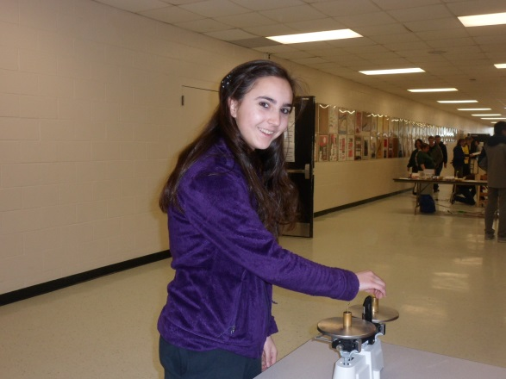
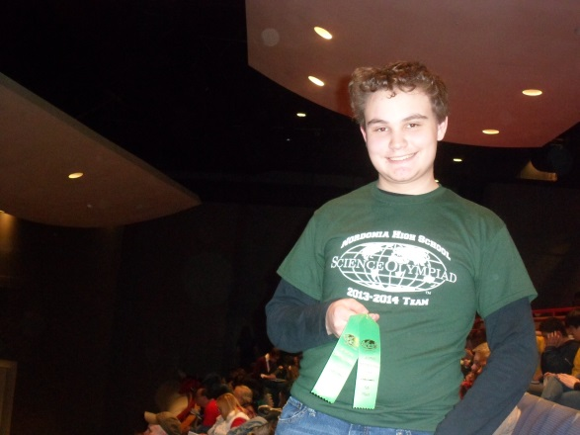
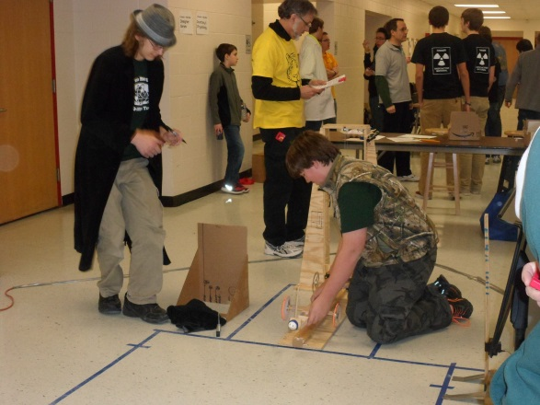
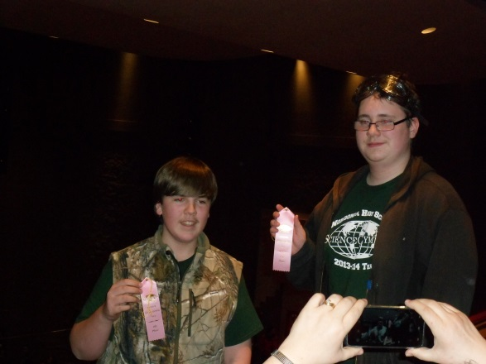
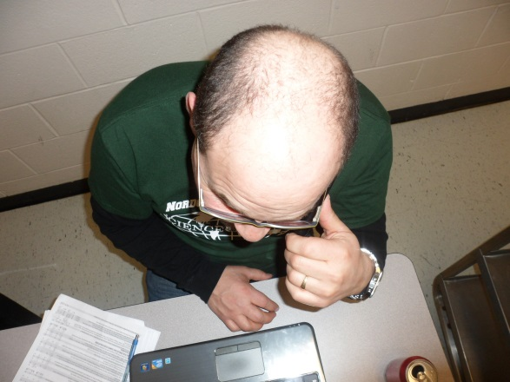
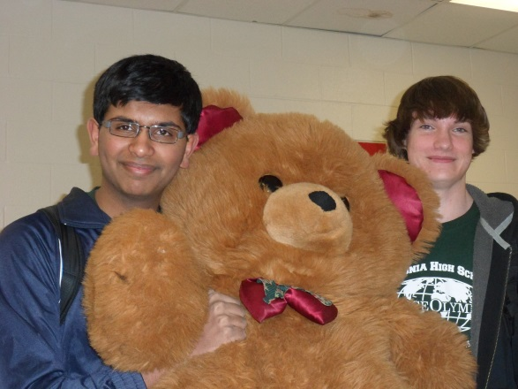
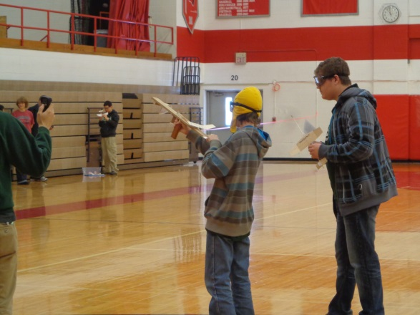
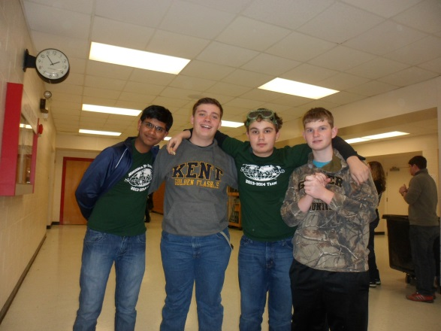
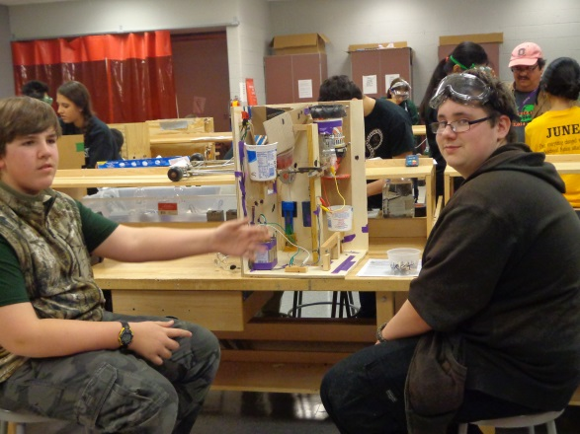

Slide 13
AKRON - HIGHLIGHTS
AWARDS: CHEM LAB-6TH, TPS-5th WQ-6th
WIDI-4th MAGLEV- 4th SCRAMBLER – 3rd
GOLD-BUNGEE, CM, ELG, XD, MP, ROCKS
4TH PLACE QUALIFIER – “TOLD YOU!”
XD – “We studied that”
Parrason’s

Slide 14
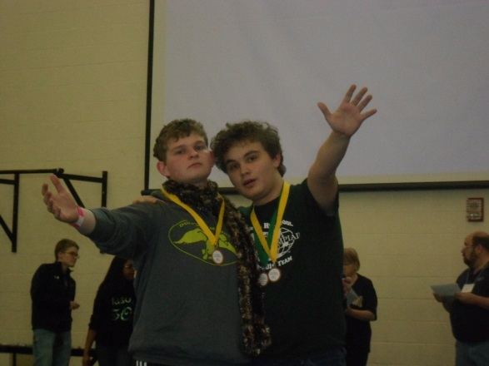
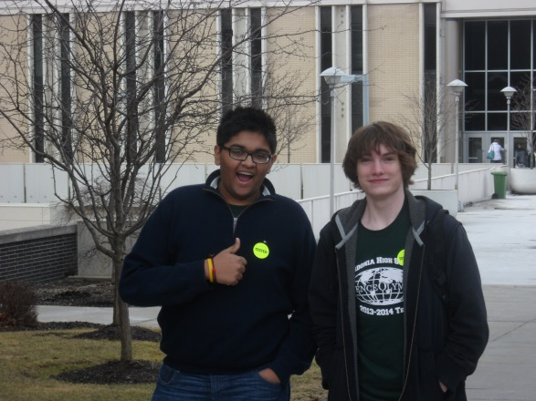
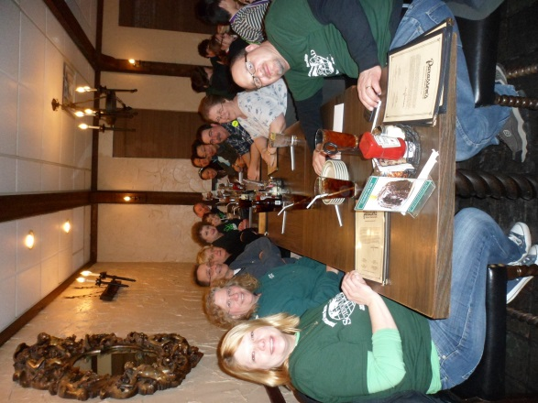
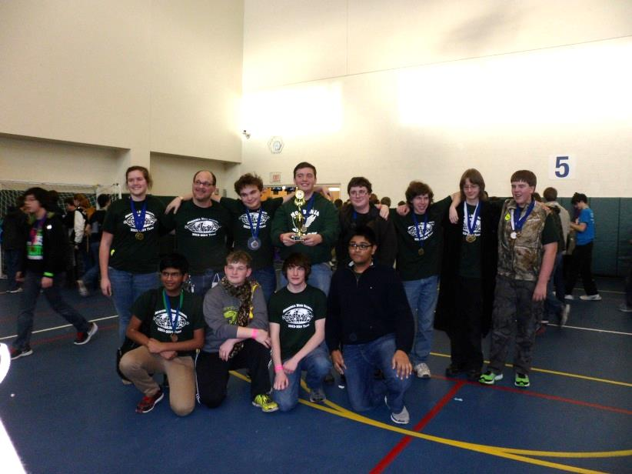
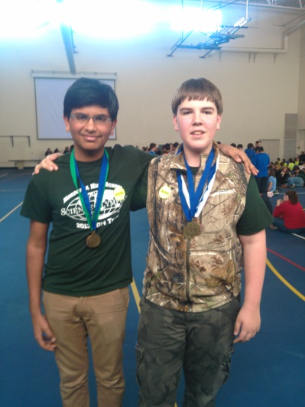
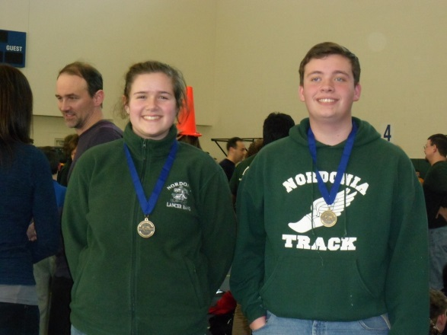
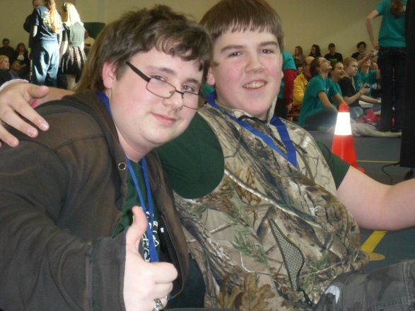
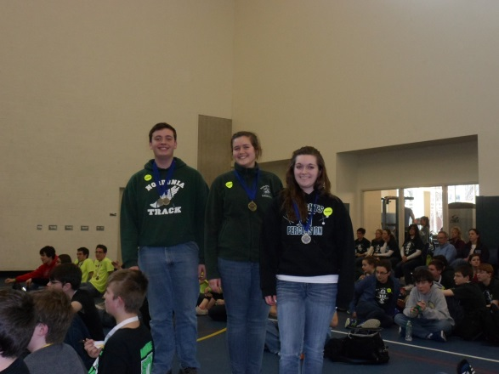
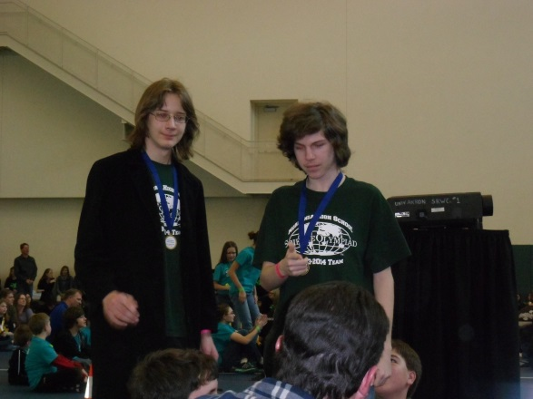

Slide 16
OSU - HIGHLIGHTS
AWARDS: WIDI-6th MP- 6th SCRAMBLER – 5th
BUNGEE -1cm
C.L. - No sleeves, MagLev – shy car!
Great Doughnuts!
B. Dub’s

Slide 17
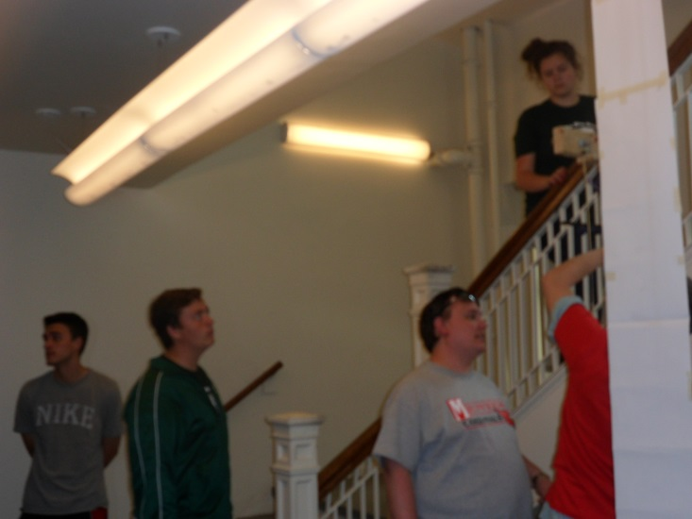
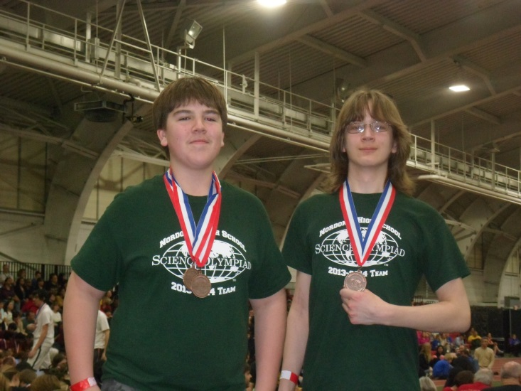
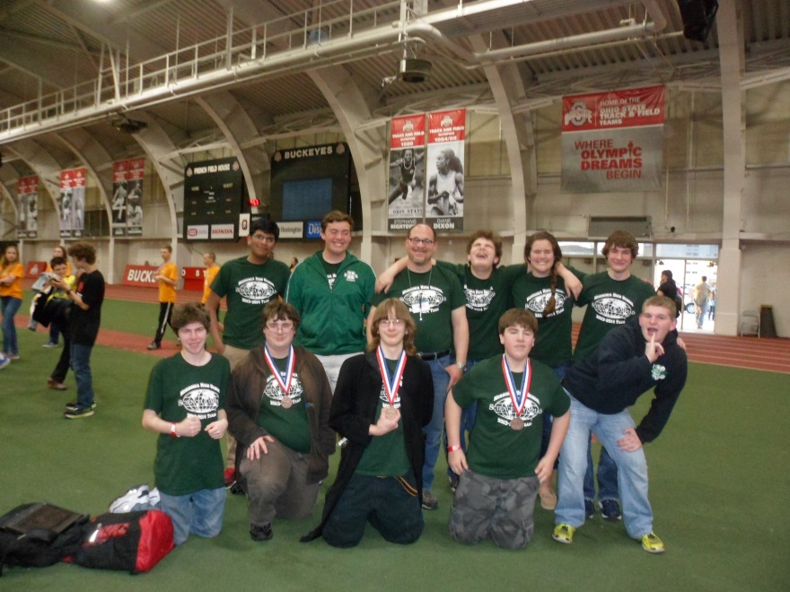
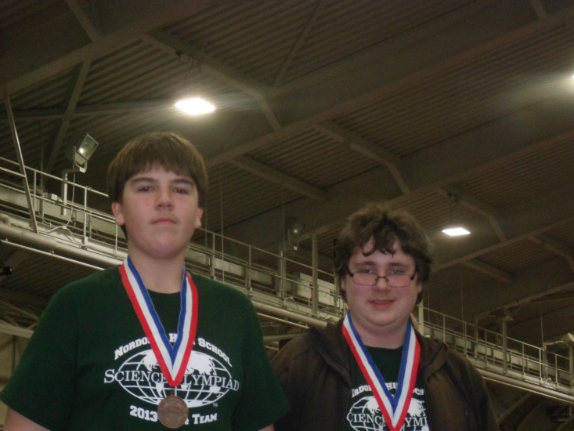
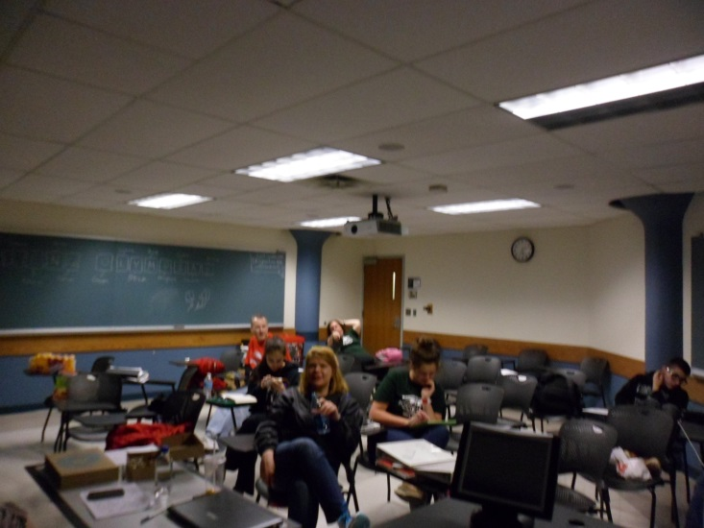
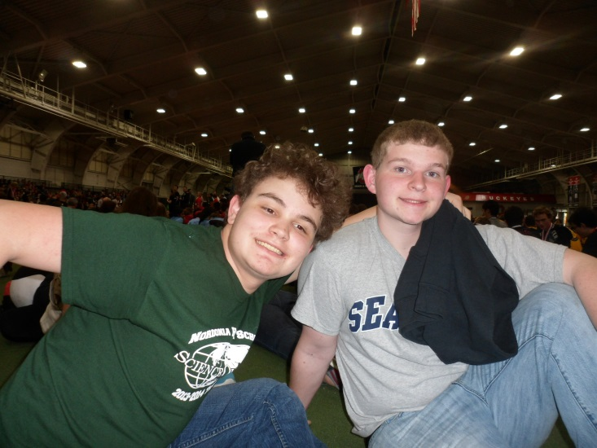
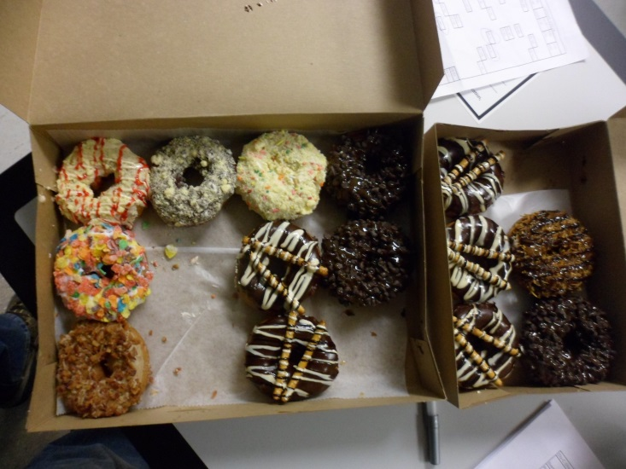
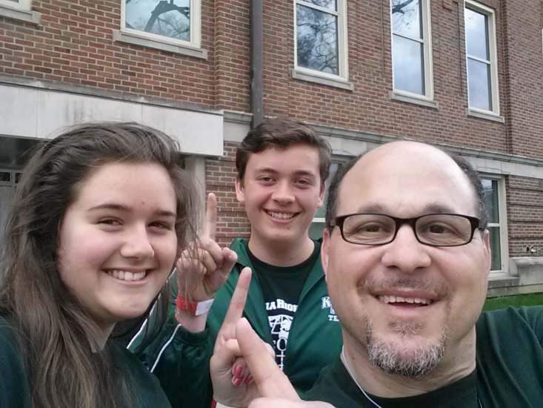

Slide 18
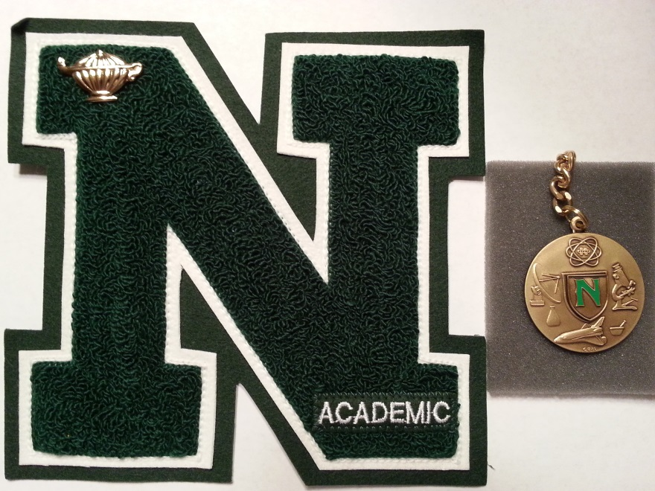
Varsity Letter Requirements
1st year Participation Certificate
1st year Letter – 3rd or better at UA/OSU
2nd and 3rd year Letters
4th year Awards

Slide 19
1ST Year Certificates
Ben Woodruff
Jon Turley
Miranda Mader
Isaac Dolan

Slide 20
1ST Year Letters
Stuart Lohrey
Matt Chilton
Rushabh Patel

Slide 21
2nd Year Letters
Alexandra Stephens
Greg Curtan
Nick Ergezi
Alex Koth
Emily Gedeon

Slide 22
3rd Year Letters
Braden Blackwell
Samantha Curnow

Slide 23
Senior Certificates
Susan Mantkowski – 1st Year, led CL A&P, loves my singing
Sunny Patel – 2nd Year, led Mat. Sci

Slide 24
4th Year Award
Eric Curtan – Forensics, MagLev, Chem Lab
Andy Krieger-WQ, Dynamic Planet, Circuits

Slide 25
Special Awards
Thank-You’s:
  D. McRaild
R. Lohrey
S. Krieger

Slide 26
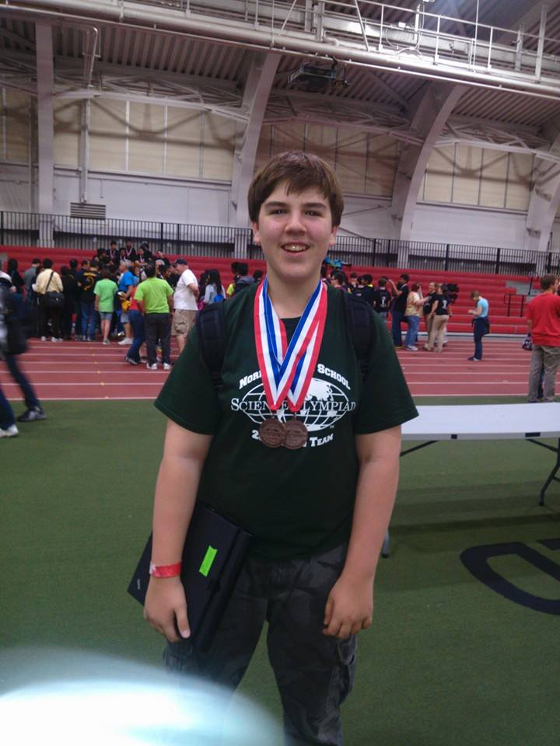
Special Awards
MVP- Matt Chilton
Received an award in ALL five competitions in 2014 – including five 3rd place or better finishes.

